Slide 1
Wednesday, March 29th
Current EVENTS
CHECK CH. 18 ASSESSMENT
NOTES TODAY
LANDMARK CASES TIMELINE DUE FRIDAY

Slide 2
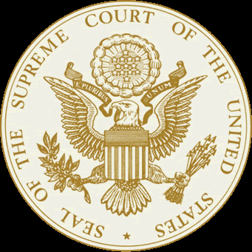
Supreme Court
Landmark Cases

Slide 3
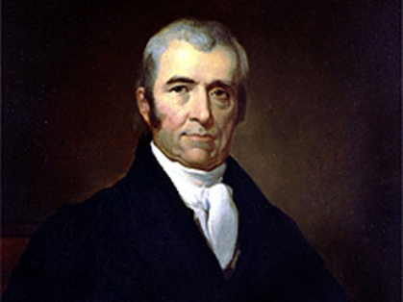
Marbury v. Madison
1803
Background Information
President John Adams appointed John Marshall as the new Chief Justice of the Supreme Court and William Marbury as the Justice of Peace for the District of Columbia before Thomas Jefferson took Office.

Slide 4
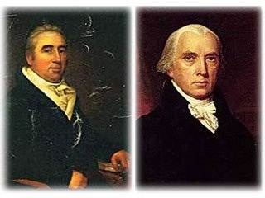
Marbury v. Madison
Not all of the appointments were finalized before the end of Adams presidency.
President Thomas Jefferson refused the remaining commissions because they were no longer valid.
Marbury (one of Adams’ appointees) sued Madison for his
government position.

Slide 5
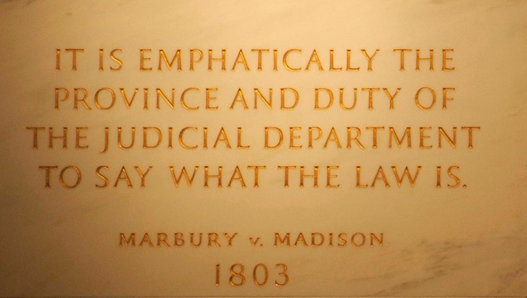
Marbury v. Madison
Results
Six (6) votes for Madison.
Helped define the checks and balances system.
Established the Supreme Court’s power of judicial review.

Slide 6
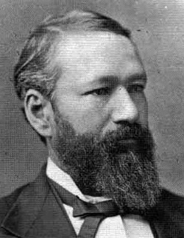
Plessy v. Ferguson
1896
Background Information
During this time, whites and blacks were required to ride in separate railway cars under Louisiana Law.
Although Homer Plessy was seven-eighths (7/8) white, he was required to ride the “colored” car.

Slide 7
Plessy v. Ferguson
Plessy was arrested for refusing to leave the “whites-only” railway car.
He took his case to state court because he felt segregation violated his Constitutional rights (14th Amendment).
The Louisiana judge, John Ferguson, ruled that Louisiana can enact segregation laws within the state.
The case was taken to the United States Supreme Court.

Slide 8
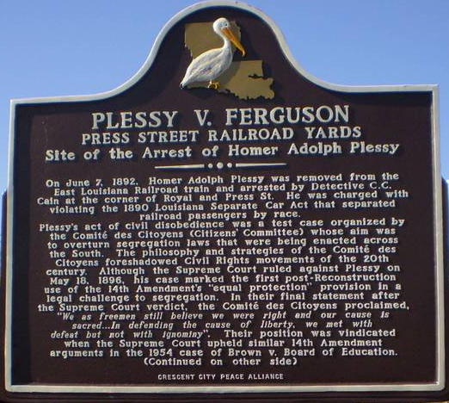
Plessy v. Ferguson
Results
Seven (7) votes for Ferguson.
This decision upheld the separate-but-equal doctrine, that separate facilities for blacks and whites satisfied the Fourteenth (14th) Amendment as long as they are “equal”.

Slide 9
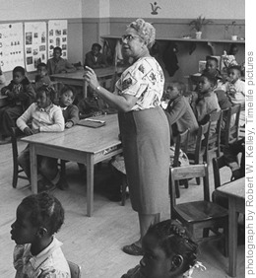
Brown v. Board of Education
1954
Background Information
Black children were NOT allowed to attend the same public schools as white children because laws permitted racial segregation.

Slide 10
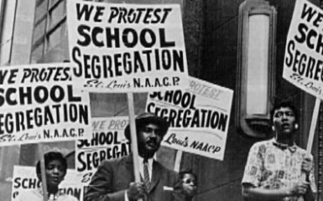
Brown v. Board of Education
Several parents of black children, including Oliver Brown, sued the Topeka School Board claiming racial segregation is unequal and violates the equal protection clause of the Fourteenth (14th) Amendment.
Lower courts agreed with the school system; the case was brought to the United States Supreme Court.

Slide 11
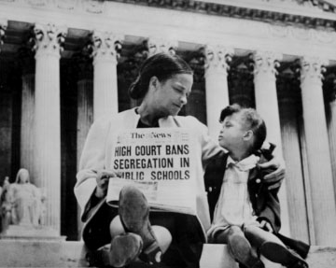
Brown v. Board of Education
Results
Nine (9) votes for Brown.
The Supreme Court overturned Plessy v. Ferguson (did away with “separate but equal”)
Racial segregation in public education is unconstitutional.

Slide 12
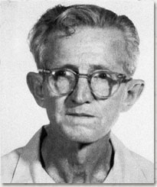
Gideon v. Wainwright
1962
Background Information
Clarence Gideon was arrested and charged in Florida court for breaking and entering.
He was unable to afford a lawyer and the court refused to appoint a free lawyer.

Slide 13
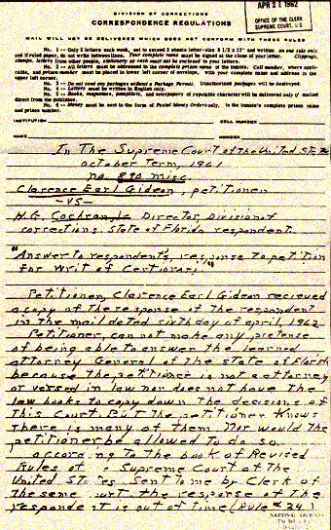
Gideon v. Wainwright
Gideon was forced to defend himself in court and the jury found him guilty.
He appealed the court’s decision to the United States Supreme Court claiming it violated his rights under the Sixth (6th) and Fourteenth (14th)Amendment.

Slide 14
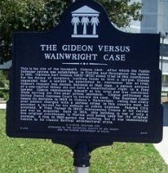
Gideon v. Wainwright
Results
Nine (9) votes for Gideon.
The Supreme Court held that Gideon and other poor defendants in criminal cases have the right to a court-appointed attorney.

Slide 15
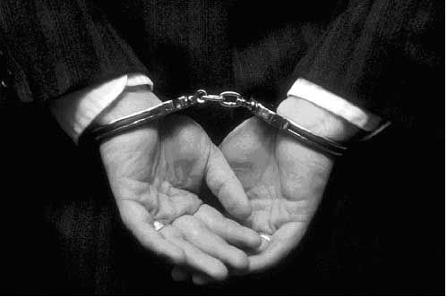
Miranda v. Arizona
1966
Background Information
Arizona arrested Ernesto Miranda for kidnapping and the state court found him guilty.
He was questioned without being advised of his right to consult with an attorney or any of his other legal rights.

Slide 16
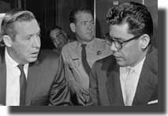
Miranda v. Arizona
Miranda appealed his conviction to the Supreme Court claiming the police violated his rights under the Fifth (5th) Amendment (self-incrimination).

Slide 17
Miranda v. Arizona
Results
Five (5) votes for Miranda, Four (4) votes for Arizona.
The decision held that the police cannot question a person in custody unless they have been read their legal rights.
1. The right to remain silent
2. The right to an attorney (at government expense if the accused is unable to pay)
3. Anything the person says after stating that he or she understands these rights can be used as evidence in court.

Slide 18
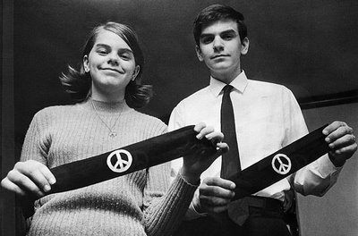
Tinker v. Des Moines
School District
1968
Background Information
John Tinker, his sister Mary Beth Tinker, and other students decided to wear black armbands to school in protest of the Vietnam War.
The school adopted a policy prohibiting armbands.

Slide 19
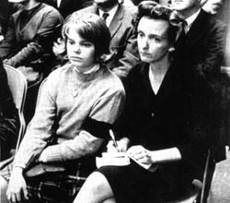
Tinker v. Des Moines
School District
When the students arrived to school, they refused to remove their armbands and were suspended.
They claimed the school officials violated their First (1st) Amendment rights.

Slide 20
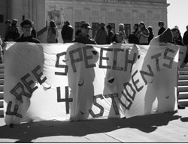
Tinker v. Des Moines
School District
Results
Seven (7) votes for Tinker, Two (2) votes against.
The students were allowed to wear armbands because it is protected by the First (1st) Amendment.

Slide 21
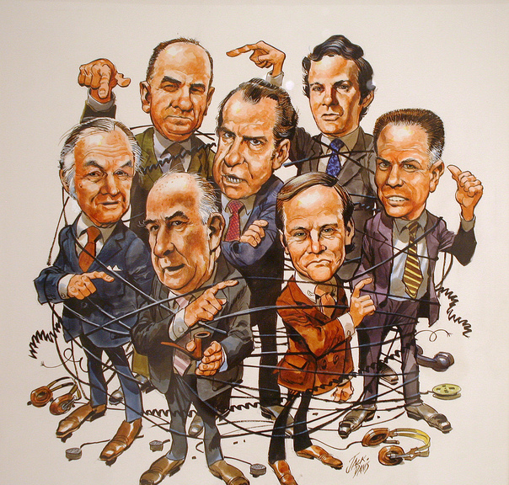
United States v. Nixon
1974
Background Information
In 1972, the offices of the Democratic Party in Washington D.C. was broken into.
During the criminal investigation, a federal judge ordered President Nixon to turn over audio tapes of conversations recorded by Nixon about the break-in.

Slide 22
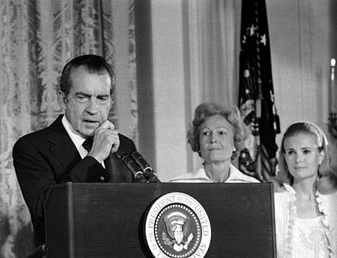
United States v. Nixon
Nixon refused and claimed “executive privilege” allowed him to withhold the conversation tapes from the other government branches and preserve confidentiality.

Slide 23
United States v. Nixon
Results
Eight (8) votes for United States, Zero (0) vote against.
The decision in this case made it clear that the president is NOT above the law.
Nixon was required to turn in the tapes which revealed evidence linking the President to the conspiracy to obstruct justice .
He resigned shortly after.

Slide 24

Hazelwood School
District v. Kuhlmeier
1987
Background Information
Students of Hazelwood East High School wrote and edited the school-sponsored newspaper.
The school principal removed two articles from the issue and claimed they were inappropriate.

Slide 25
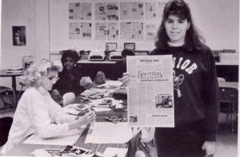
Hazelwood School
District v. Kuhlmeier
Cathy Kuhlmeier and two other students brought the case to court because they believed the principal violated their First (1st) Amendment rights.

Slide 26

Hazelwood School
District v. Kuhlmeier
Five (5) Votes for the Hazelwood School District, Three votes for Kuhlmeier
The Supreme Court ruled that school officials have the right to censor articles in the student newspaper or limit speech that interferes with the school’s educational mission.
Results

Slide 27
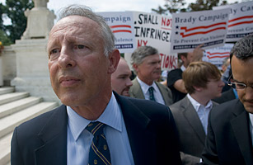
District of Columbia v. Heller
2007
Background Information
After the District of Columbia passed a law requiring the registration of handguns, requiring licenses for all pistols, and mandating that all legal firearms must be kept unloaded and disassembled or trigger locked, a group of private gun-owners brought suit claiming the laws violated their Second Amendment right to bear arms.

Slide 28

District of Columbia v. Heller
2007
Background Information
The federal court that heard the case first said the Second Amendment only protected ownership of firearms for those associated with a militia, like the National Guard.
The Court of Appeals, who heard the case next, voted 2-1 in favor of protecting private ownership.
D.C. appealed the case to the United States Supreme Court.

Slide 29

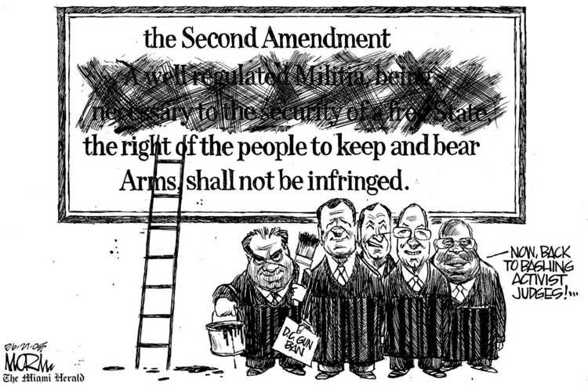
District of Columbia v. Heller
Results
In a 5 (Heller) - 4 (D.C.) decision, the Court held that the Second Amendment does protect an individual right to possess a firearm unconnected with service in a militia, and to use that firearm for traditionally lawful purposes, such as self- defense within the home.

Slide 30
Thursday, March 30th
Complete Guided Reading 7.3/7.4 Use the textbook/notes The guided reading packet should be turned in by the end of class.
Current Events
All tests and quizzes should be made up today.

Slide 31
Thursday, March 30th
Finish notes on landmark cases – 3rd, 6th period
Work on Landmark Cases Timeline assignment – this will be DUE Monday
Current Events

Slide 32
Mapp v. Ohio (1961)
Background:
In this case, Cleveland police entered a home forcefully and without a warrant. They were searching for a suspect, and found obscene materials. They used these to convict Mrs. Mapp for possession of obscene materials.

Slide 33
Mapp v. Ohio
Ruling:
The court overturned her conviction, holding that the evidence against her had been found and seized without a warrant.
This effectively extended the exclusionary rule to state/local officers not just federal officers.
The U.S. Supreme Court ruled in a 5-3 vote in favor of Mapp.

Slide 34
Texas v. Johnson
Background
  In 1984, in front of the Dallas City Hall, Gregory Lee Johnson burned an American flag as a means of protest against presidential policies
  He was sentenced to one year in jail and assessed a $2,000 fine.

Slide 35
Texas v. Johnson
Is the desecration of an American flag a form of speech that is protected under the First Amendment?
In a 5-to-4 decision, the Court held that Johnson's burning of a flag was protected expression under the First Amendment. The Court found that Johnson's actions fell into the category of expressive conduct and had a distinctively political nature. The fact that an audience takes offense to certain ideas or expression, the Court found, does not justify prohibitions of speech.
"[i]f there is a bedrock principle underlying the First Amendment, it is that the Government may not prohibit the expression of an idea simply because society finds the idea itself offensive or disagreeable."

Slide 36
Roe v. Wade
Background
A unmarried pregnant woman, Roe, challenged a Texas statute that made it a crime to seek or perform an abortion except when, in a doctor’s judgment, abortion would be necessary to save the mother’s life.
Roe’s life had not been threatened by her pregnancy, she had not been able to obtain an abortion in Texas.

Slide 37
Roe v. Wade
Ruling
The Court decided in Roe’s favor.
“The right of privacy(1^{st,} 4th, 5th, 9th, 14th amendments) . . . is broad enough to encompass a woman’s decision whether or not to terminate her pregnancy.”
The Court decided that a fetus was not a person under the 14th amendment, Nonetheless, the state has valid interests to protect both
  the health of the pregnant woman
  the potentiality of human life.
A state may regulate abortion procedures in such areas as doctors’ qualifications and licensing of facilities.
Each state chooses the timeframe for when an abortion, outside of protecting the woman, is banned.

